Slide 1
Performance Analysis of ML Algorithms trained on Life threatening diseases
Waqas Kureshy
Neeharika Yeluri
Jasmine Wang

Slide 2
Problem Definition
The idea behind our project was to work on different health related datasets, materialise different models for each dataset and compare their performance.
Datasets:
Cardiovascular Disease Dataset
Diabetes Dataset
Breast Cancer Dataset
Models include:
Artificial Neural Network (Sequential Model)
SVD
Decision Trees
Logistic Regression etc.

Slide 3
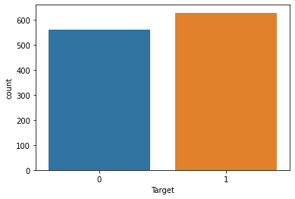
Dataset: CVD (Cardiovascular Diseases )
Dataset comprised of 1190 cases and is taken from OpenML
Spans over 12 classes
Attributes include:[ Age, Sex, Chest Pain Type, Resting Blood Pressure, Cholesterol, Fasting Blood Sugar. Resting ECG, Max Heart Rate, Exercise Angina, Old Peak, ST Slope, Target ]
Target is categorised as 0 for no disease and 1 for having the CVD disease respectively.
Distribution of target

Slide 4
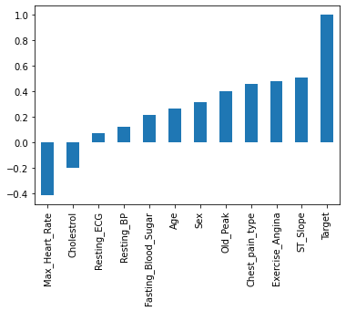
Data Exploration
Initial exploration of the data suggests:
9 Features have positive correlation with the target variable.
The attribute ST Slope has the highest correlation (The ST segment encompasses the region between the end of ventricular depolarization and beginning of ventricular repolarization on the ECG ).

Slide 5
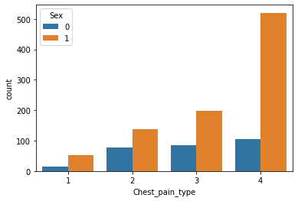
Data Exploration
Chest Pain type | Value
Typical Angina | 1
Atypical Angina | 2
Non-Anginal | 3
Asymptotic | 4

Slide 6
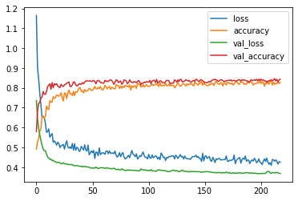
Models: Artificial Neural Network
Three models were made, their specifications and performance metrics are compiled in the succeeding slides
ANN:
a Sequential Tensorflow keras model with 3 hidden layers and 1 output layer.
SELU ( ) activation function, this function was used for normalization.
A Dropout layer was used to avoid overfitting.
A callback Early-Stopping which monitored the validation loss metric was also used to prevent overfitting.
The neural network was trained for 600 epochs , but the training was stopped at 85 epochs due to the early stop callback.
Model Accuracy and Loss

Slide 7
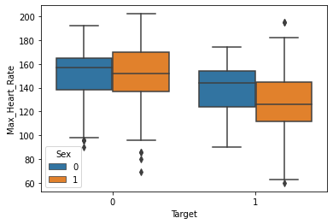
Models: SVM
Exploratory data analysis was conducted using the Seaborn library.
The set was distributed into training and testing data and then scaled using a Minmax scaler.
The model was evaluated using the Confusion matrix and Classification Report metrics.
Max heart rate of patients separated by Gender and target

Slide 8
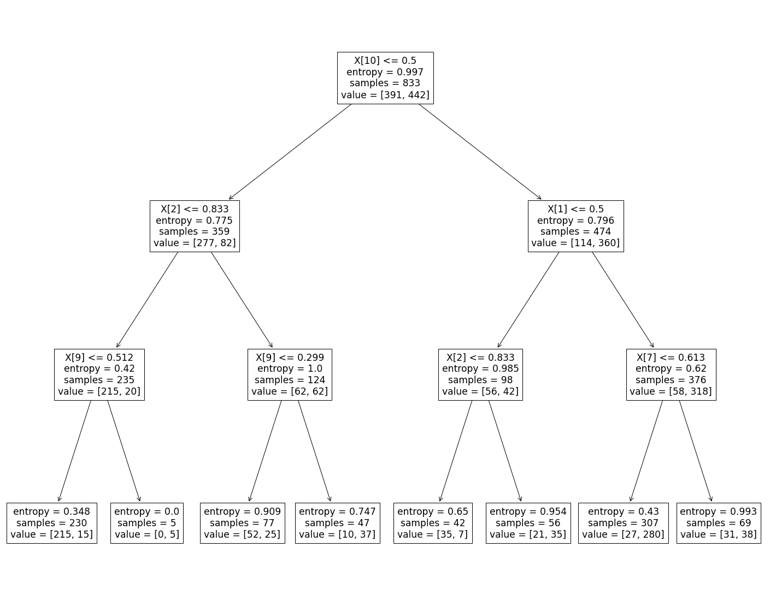
Model: Decision Tree
The set was distributed into training and testing data and then scaled using a Minmax scaler.
The model was trained using a Decision Tree classifier with the entropy criterion with a max depth of 4.

Slide 9
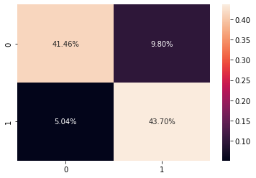
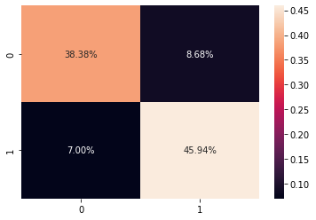
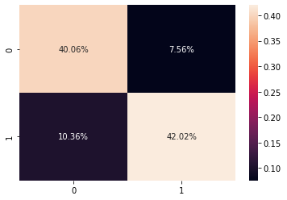
Model Comparisons
SVM
ANN
Decision Tree

Slide 10
Classification reports
ANN |  | Precision | Recall | F-1
 | 0 | 0.85 | 0.82 | 0.83
 | 1 | 0.84 | 0.87 | 0.85
 | accuracy |  |  | 0.84
Decision Tree |  | Precision | Recall | F-1
 | 0 | 0.85 | 0.82 | 0.83
 | 1 | 0.84 | 0.87 | 0.86
 | accuracy |  |  | 0.85
SVM |  | Precision | Recall | F-1
 | 0 | 0.89 | 0.81 | 0.85
 | 1 | 0.82 | 0.90 | 0.85
 | accuracy |  |  | 0.85

Slide 11
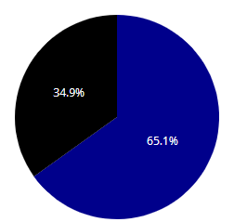

Dataset: Diabetes
Dataset consists of 9 attributes in which one of them is target variable “Outcome”.
Attributes: [Pregnancies, Glucose, BloodPressure, SkinThickness, Insulin, BMI, DiabetesPedigreeFunction, Age and Outcome].
It has 768 observations overall.
Class variable has the outcome of either 0 or 1. (0: Tested Negative, 1: Tested Positive)
Pie Chart of Diabetes

Slide 12
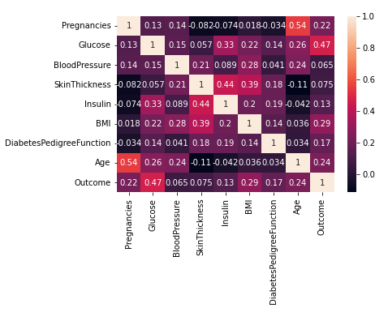
Exploratory Data Analysis
The heat map analysis shows that the following features are positively correlated with the target variable [Pregnancies, Glucose, BloodPressure, SkinThickness, Insulin, BMI, DiabetesPedigreeFunction and Age].
It seems to be there are no missing values but there may be missing values hidden in the data of the variables here.

Slide 13
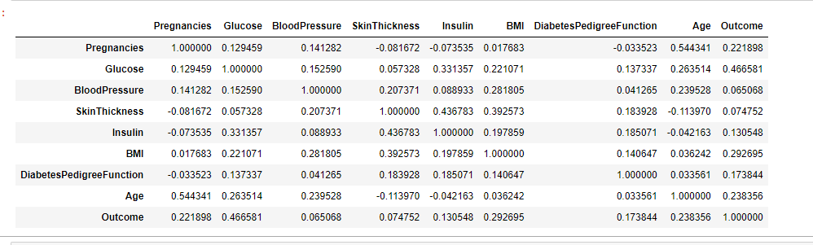
All the attributes have a positive correlation with the outcome in which glucose having the highest correlation and blood pressure being the lowest.

Slide 14
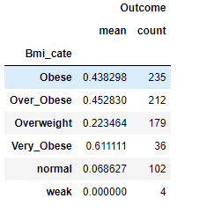
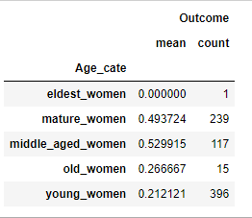
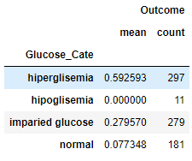
Important factors which affect the target variable the most[BMI, Age, Glucose]

Slide 15
Models used for Diabetes Dataset
Logistic Regression
Decision Tree Classification
SVM

Slide 16
Model: Logistic Regression
The dataset was distributed into training and testing data and then scaled using Standard scaler.
The model was trained using a Logistic Regression method and the accuracy was predicted.
The model was evaluated using the Confusion matrix and Classification Report metrics. These results are summarized and compared in the Comparison section along with other algorithms.
Roc_auc_score - 0.74

Slide 17
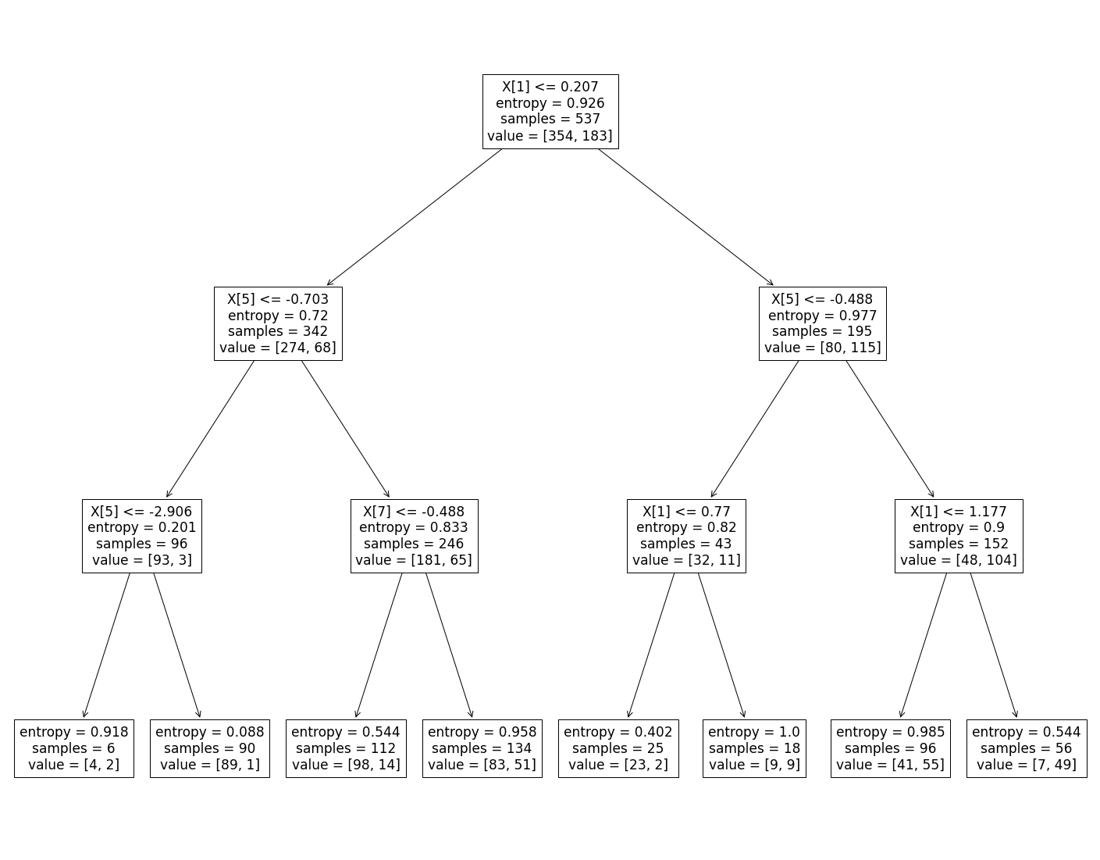
Model: Decision Tree
The model was trained using a Decision Tree classifier with the entropy criterion with a max depth of 3.

Slide 18
Model: SVM
8 data columns are selected as features and the target column (Outcome) is the label.
The model was trained using a Support Vector Classifier and then Accuracy, Confusion Matrix and the Classification Report metrics were evaluated for both the training and testing data.

Slide 19
Model Comparisons: Confusion Matrix
Model | TP | FP | FN | TN
Logistic Regression | 132 | 36 | 14 | 49
Decision Tree | 124 | 31 | 22 | 54
SVM | 132 | 35 | 14 | 50

Slide 20
Classification reports: Diabetes
Logistic Regression |  | Precision | Recall | F-1
 | 0 | 0.79 | 0.90 | 0.84
 | 1 | 0.78 | 0.58 | 0.66
 | accuracy |  |  | 0.78
Decision Tree |  | Precision | Recall | F-1
 | 0 | 0.80 | 0.85 | 0.82
 | 1 | 0.71 | 0.64 | 0.67
 | accuracy |  |  | 0.77
SVM |  | Precision | Recall | F-1
 | 0 | 0.79 | 0.90 | 0.84
 | 1 | 0.78 | 0.59 | 0.67
 | accuracy |  |  | 0.79

Slide 21
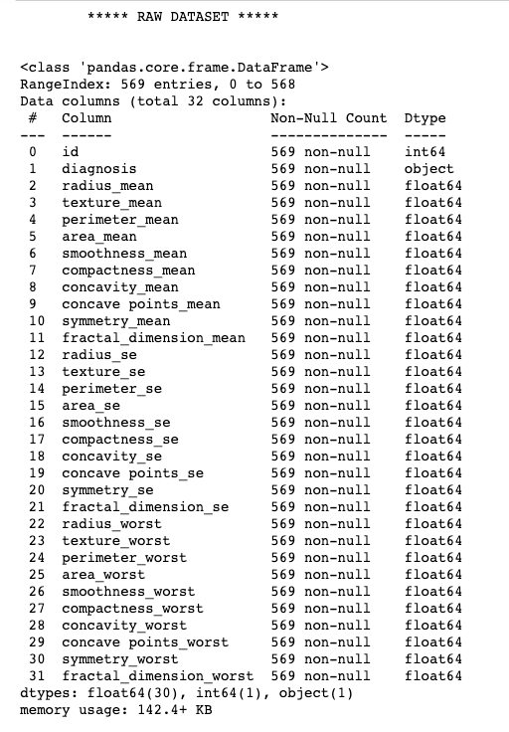
Example Analysis
– Breast Cancer dataset
Define the question
Breast cancer accounts for 25% of all cancer cases.
Need to classify tumors into malignant vs. benign.
Dataset:
It has rich features describing tumors from different angles(mean, standard deviation, and worst).
It provides preliminary diagnosis as M(alignant) or B(enign).
It contains 569 records with 32 attributes.

Slide 22
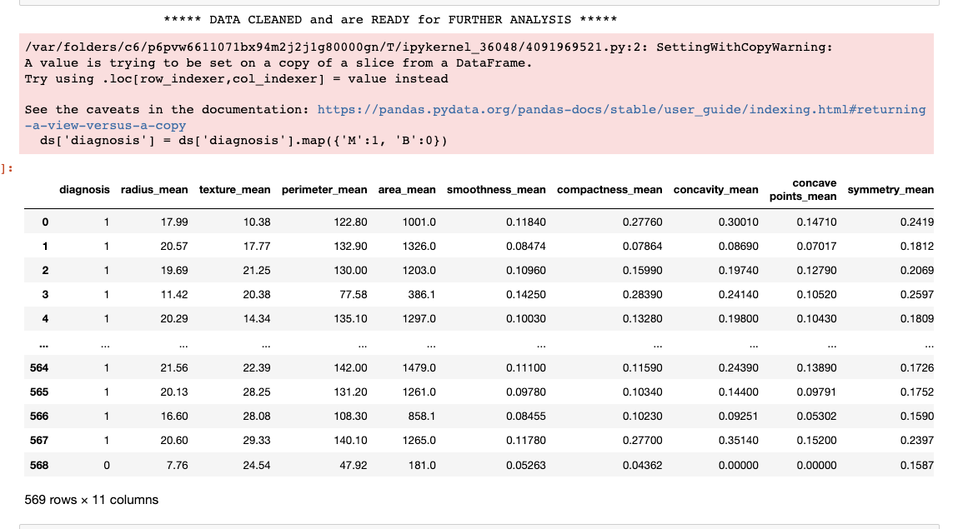
Example Analysis
– Tidy the data
Eliminate the _worst features & _se features.
Change the diagnosis feature from categorical[M, B] to numerical[1, 0].

Slide 23
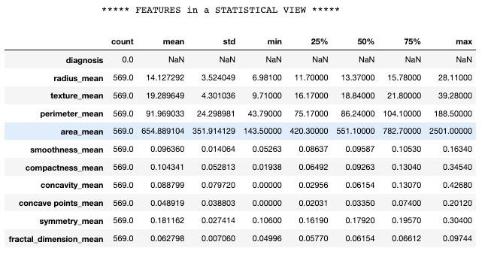
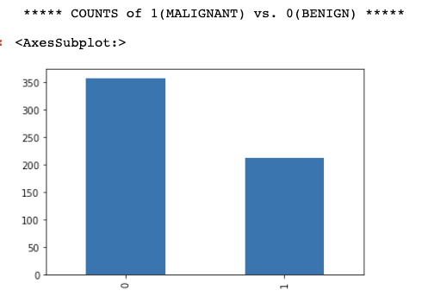
Example Analysis
– explore the data
Understand distribution of _mean features.
Understand distribution of target variable diagnosis [Malignant vs. Benign]

Slide 24
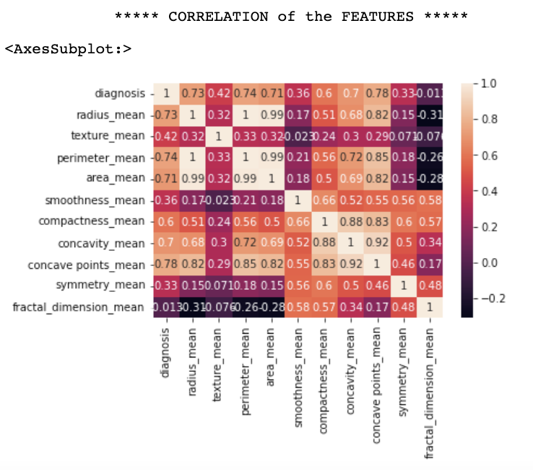
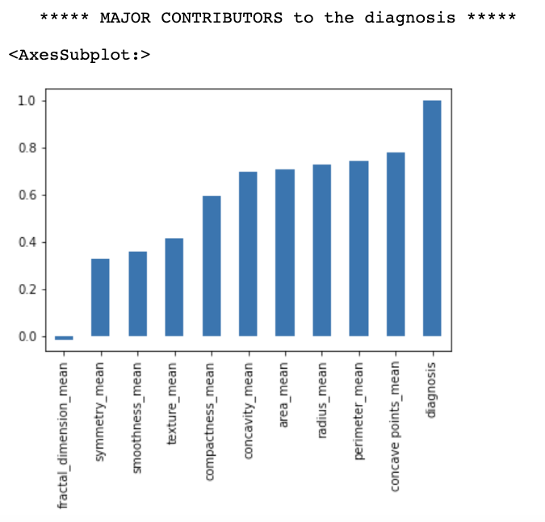
Example Analysis
– explore the data (cont’d)
Heatmap shows the correlation of the features with each other.
Value_counts plot is a further proof of the major contributors.

Slide 25
Example Analysis
– models & techniques
Models
Test KNeighborsClassifier, GaussianNB, RandomForestClassifier and SGDClassifieruse, together with LogisticRegression and SupportVectorMachine.
Use the former four models in one shot so that it’s code-efficient and model comparisons are in one place.
Drop the latter two since other teammates use them.
Techniques
10 data columns ending with _mean are selected as features X, and standardized using StandardScaler.
The diagnosis column is selected as a label y.
The dataset is split into training and testing data as 80% vs. 20%.

Slide 26
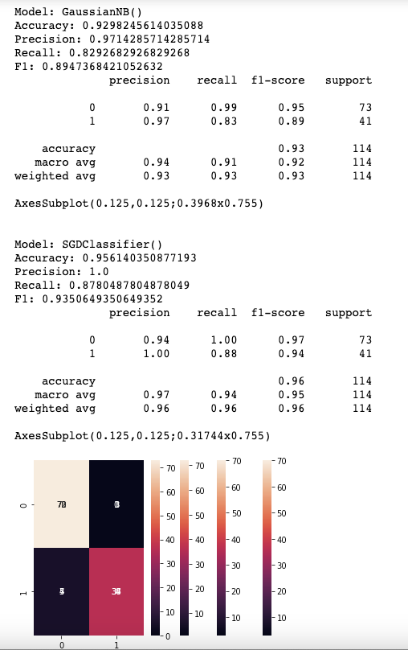
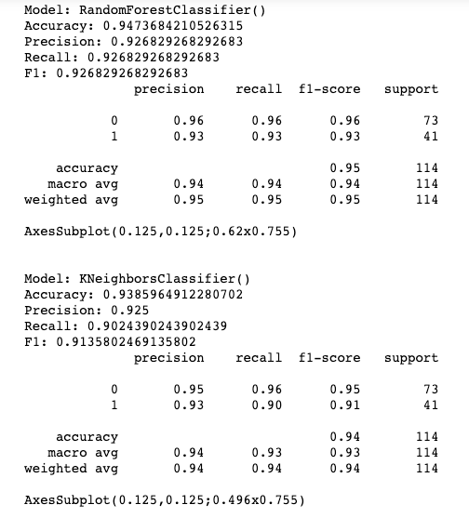
Example Analysis
– perform the analysis
& check results

Slide 27
Conclusion
The data is assumed to be IID (Independent Identically Distributed) generated from a target distribution P[y|x], and from this same distribution we obtain test points Independently as well.
According to the 2-step learning process: the question is not about choosing the most complicated hypothesis set, because a much simpler hypothesis set may very well be able to adapt to the problem (Optimal Tradeoff).
For learning, "Error", is user defined. To measure error in our experiments, we have used metrics like Classification report and Confusion matrices to quantify the error of our trained models.
Validation scores and test scores all demonstrate how well models can generalize and then eventually apply to unseen data, which show models can indeed learn.

Slide 28
References
CVD Dataset <https://www.openml.org/search?type=data&status=active&id=43672>
Breast Cancer Dataset <https://www.openml.org/search?type=data&status=active&id=1510>
Diabetes Dataset <https://www.openml.org/search?type=data&status=active&id=42608>

Slide 29
Thank you !

